Slide 1
SWE3002: Information & Systems Security
Module 2 Block Cipher
Prof. Jayasudha M, VIT Chennai

Slide 2
Block Cipher
Block Vs Stream
DES
AES
BLOWFISH
TWOFISH

Slide 3
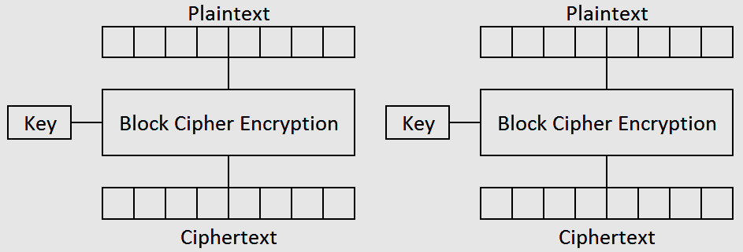
ECB(Electronic code block)
Simplest block cipher mode
Each block of plaintext is encrypted separately

Slide 4
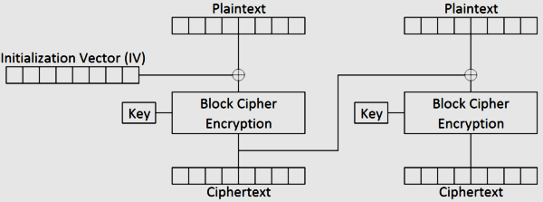
CBC(cipher block chain)
Initialization vector (IV) is exclusive-ored with the plaintext
To fix the issue with ECB mode where identical plaintext blocks create identical ciphertext blocks

Slide 5
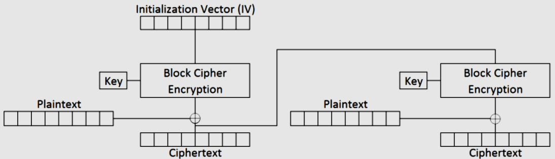
CFB(cipher feedback)
The output of the encryption is exclusive-ored with the plaintext and this value is used as the next block's IV

Slide 6
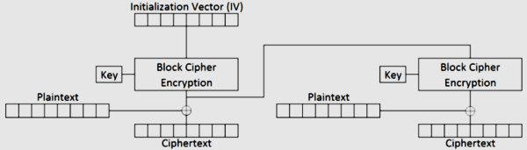
OFB(Output feedback)
The output of the encryption is used as the next block's IV
Encryption of the same plaintext with the same key using CFB and OFB modes
Produce the same ciphertext for the first block but different ones for every other block.

Slide 7
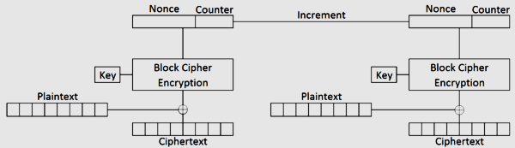
CTR(Counter mode)

